Slide 1

ONLINE NEWS:
PREDICTING POPULARITY OF NEWS ITEMS
Akbar Aidarov • Michael Janke • Monica Stettler • Samiyah Reed • Siravich Khongrod

Slide 2
RESEARCH QUESTION
Can we predict the popularity of a news item by predicting the number of times it is shared online?
Notes:
Predict the number of shares and making inferences about the popularity.

Slide 3


DATASET
39,737 0nline news items from Mashable
61 attributes
46 numerical
14 categorical
No missing values
TARGET VARIABLE:
Number of article shares
Fernandes et al., 2015
Notes:
The researchers, Fernandez et al [1], who donated our dataset worked to create an optimization model to help authors evaluate their news items before publishing them. Other authors (Bandari et al, 2012) had a similar goal to Fernandez et al, but applied different techniques. Other research (Tatar et al, 2011) suggested evaluating user comments as predictor of popularity.
Source of the data: UCI Machine Learning Repository

Slide 4
VARIABLES SUMMARY
WORDS
Number of words in the title (#)
Number of words in the article (#)
Average word length (#)
Rate of non-stop words (ratio)
Rate of unique words (ratio)
Rate of unique non-stop words (ratio)
KEYWORDS
Number of keywords (#)
Worst keyword (#)
Average keyword (#)
Best keyword (#)
Mashable data channel (nominal)
NATURAL LANGUAGE PROCESSING
Closeness to top 5 LDA topics (ratio)
Title subjectivity (ratio)
Article text subjectivity score (ratio)
Title sentiment polarity (ratio)
Rate of positive & negative words (ratio)
Pos. words rate among non-neutral words (ratio)
Neg. words rate in non-neutral words (ratio)
Polarity of positive words (ratio)
Polarity of negative words (ratio)
Article text polarity score (ratio)
LINKS
Number of links (#)
Number of Mashable article links (#)
Shares of Mashable links (#)
Digital Media
No of images
No of videos
Time
Day of the week (nominal)
Weekend? (bool)

Slide 5

PRE-PROCESSING
MANY OF THE VARIABLES HAVE SKEWED DISTRIBUTIONS
Some are count values
Some are ratio
SOME ARE BOOLEAN
outliers

Slide 6

PRE-FLIGHT CHECK
CORRELATIONS
TESTING
Based on the Bartlett’s test of Sphericity and on our analysis of the correlation table, we found many significant correlations among the independent variables (IVs). This provides an opportunity for exploration of latent meaning and also means that multicollinearity must be dealt with .
There are also 24 significant correlations between the IVs and the target variable which indicates a predictive model can be built
BARTLETT’S TEST OF SPHERICITY
Chi-Squared = 20,400,000, p < 0.001
There is significant correlation to exploit in the data
KMO measure of sample adequacy
Overall MSA = 0.61
Indicates stability

Slide 7
SIGNIFICANT CORRELATIONS Note: tokens = words
n_tokens_title | 28 |  | kw_max_max | 30 |  | global_rate_positive_words | 33
n_tokens_content | 36 |  | kw_avg_max | 36 |  | global_rate_negative_words | 33
n_unique_tokens | 4 |  | kw_min_avg | 29 |  | rate_positive_words | 39
n_non_stop_words | 6 |  | kw_max_avg | 34 |  | rate_negative_words | 32
n_non_stop_unique_tokens | 4 |  | kw_avg_avg | 37 |  | avg_positive_polarity | 36
num_hrefs | 36 |  | self_reference_min_shares | 23 |  | min_positive_polarity | 30
num_self_hrefs | 31 |  | self_reference_max_shares | 33 |  | max_positive_polarity | 33
num_imgs | 38 |  | self_reference_avg_sharess | 31 |  | avg_negative_polarity | 37
num_videos | 34 |  | LDA_00 | 32 |  | min_negative_polarity | 34
average_token_length | 41 |  | LDA_01 | 28 |  | max_negative_polarity | 32
num_keywords | 33 |  | LDA_02 | 40 |  | title_subjectivity | 32
kw_min_min | 31 |  | LDA_03 | 36 |  | title_sentiment_polarity | 29
kw_max_min | 13 |  | LDA_04 | 35 |  | abs_title_subjectivity | 21
kw_avg_min | 22 |  | global_subjectivity | 37 |  | abs_title_sentiment_polarity | 32
kw_min_max | 28 |  | global_sentiment_polarity | 33 |  | shares | 24

Slide 8
PRINCIPAL COMPONENT ANALYSIS
LOOKING FOR MEANING & MANAGING MULTICOLLINEARITY

Slide 9
PCA process
Removed categorical variables (day of week and news channels)
Scaled and centered (some data ratios, some large count, some small)
Varimax rotation
Loading significance cutoff= 0.4

Slide 10
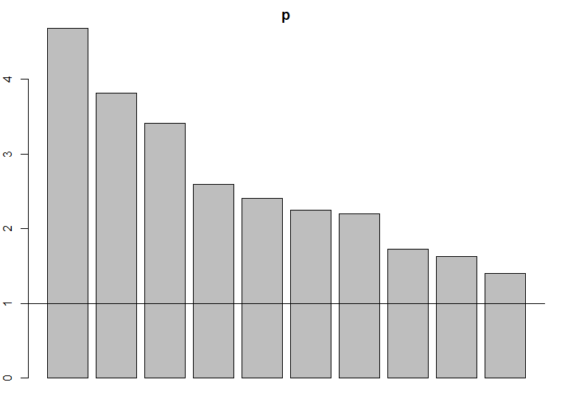
CHOOSING PC’s
How many PC’s to use?
Kaiser = 10 PC’s
Scree plot knee = 5 PCs
We used % variance explained
6 PC’s = 45.6% variance explained
RC1 RC2 RC3 RC4 RC6 RC5
SS loadings 4.435 3.557 3.156 3.117 2.454 2.443
Proportion Var 0.106 0.085 0.075 0.074 0.058 0.058
Cumulative Var 0.106 0.190 0.265 0.340 0.398 0.456

Slide 11
MEANINGS & LOADINGS
Positive words (PC1)
average_token_length 0.712
global_subjectivity 0.818 global_rate_positive_words 0.598
rate_positive_words 0.626
avg_positive_polarity 0.789
max_positive_polarity 0.708
Fewest good keywords (PC3)
kw_max_min 0.811
kw_avg_min 0.799
kw_max_avg 0.840
kw_avg_avg 0.769
Links & images (RC6)
n_tokens_content 0.743
num_hrefs 0.605
num_self_hrefs 0.506
num_imgs 0.458
Word Polarity & Negativity (PC2):
global_sentiment_polarity 0.775
global_rate_negative_words -0.769
rate_negative_words -0.888
avg_negative_polarity 0.552
min_negative_polarity 0.631
Most good keywords (PC4):
kw_min_min -0.618
kw_max_max 0.646
kw_avg_max 0.842
kw_min_avg 0.539
Kw_min_max 0.442
RC5 (Language subjectivity & sentiment – NLP)
Self_reference_min_shares -0.532
self_reference_max_share -0.539
self_reference_avg_shares -0.618
title_subjectivity 0.622
abs_title_subjectivity -0.500
abs_title_sentiment_polarity 0.632

Slide 12
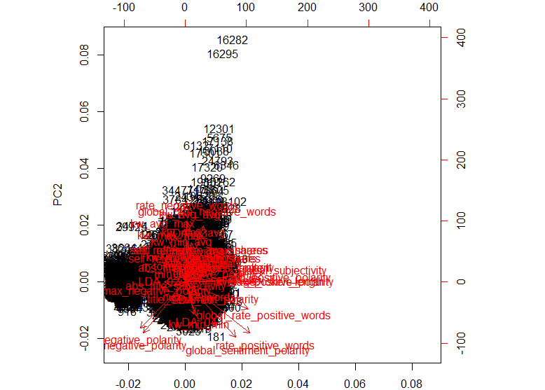
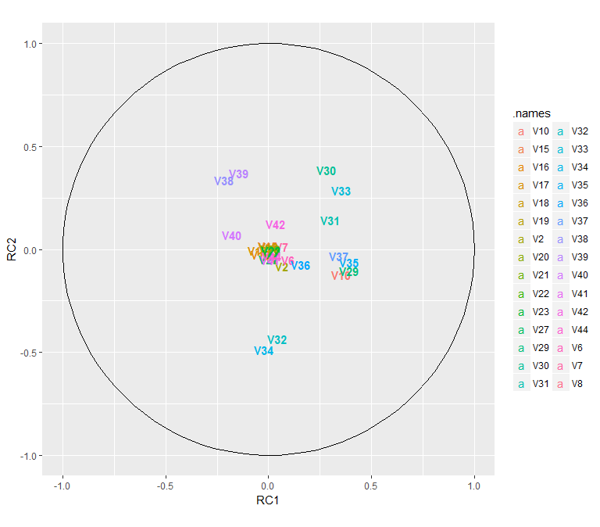
PCA Plots

Slide 13
Factor Analysis (CFA)
Extracting and interpreting factors

Slide 14
VIF Scores
Notes:
V33-34 = rate of positive and negative words
V24-28 = Closeness to LDA topic 0, Closeness to LDA topic 1, Closeness to LDA topic 2, Closeness to LDA topic 3, Closeness to LDA topic 4
V3-5 = Rate of unique words in the content, Rate of non-stop words in the content, Rate of unique non-stop words in the content

Slide 15
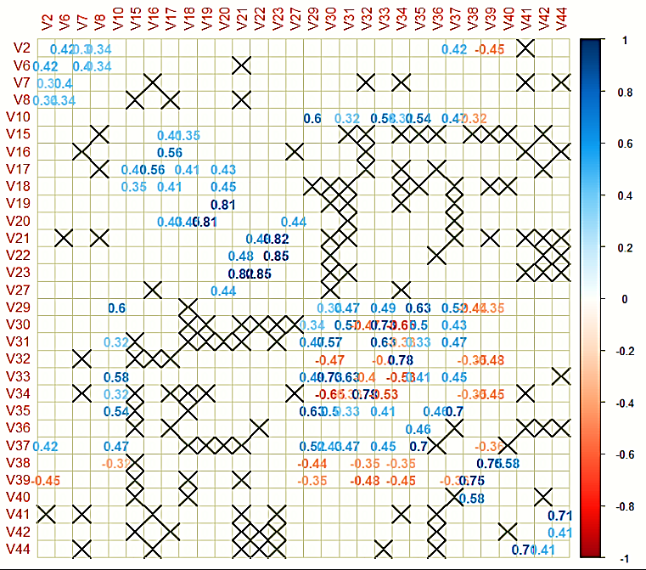
Correlations
Only variables with strong and significant correlations (|r| > 0.3, p < 0.01) were used (30 variables):
Bartlett’s test: χ² = 20,362,000, df = 29, p-value < 2.2e-16
KMO: Overall MSA = 0.61

Slide 16
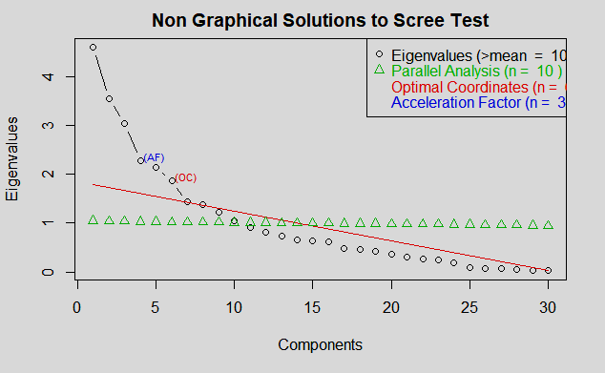
Scree Plot Analysis
Number of factors:
Kaiser = 10
Parallel Analysis = 10
Optimal = 6
Acceleration = 3
5 factors chosen
Factor 6 was unstable with only 2 loadings.

Slide 17
Naming Factors
Positivity of content (Factor 1)
average_token_length 1.007
rate_positive_words 0.648
avg_positive_polarity 0.646
global_subjectivity 0.635
max_positive_polarity 0.550
Negativitiy of content (Factor 2):
rate_negative_words 1.031
global_rate_negative_words 0.781
global_sentiment_polarity -0.665
global_rate_positive_words -0.436
Cumulative Var 0.433
Popularity of keywords (Factor 3)
kw_avg_avg 1.000
kw_max_avg 0.822
kw_min_avg 0.455
LDA_03 0.411
kw_avg_max 0.410
Popularity of references (Factor 4)
self_reference_min_shares 0.996
self_reference_max_share 0.844
self_reference_avg_shares 0.824
Polarity of negative words (Factor 5)
avg_negative_polarity 0.991
max_negative_polarity 0.664
min_negative_polarity 0.658

Slide 18
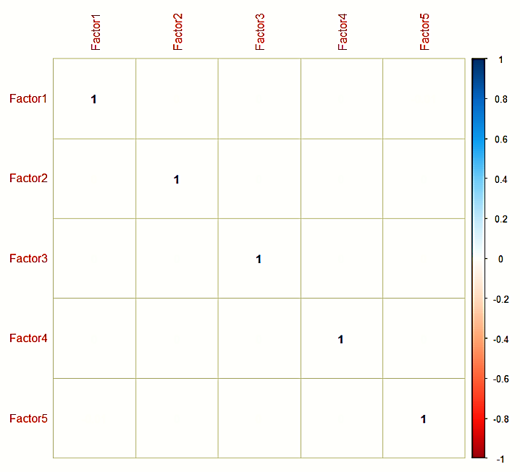
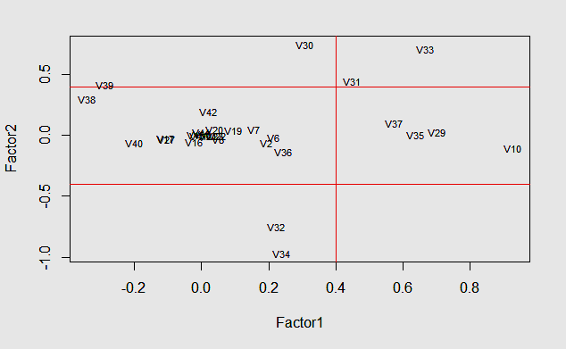
Independence of Factors

Slide 19
Canonical Correlation Analysis
Comparing Principal Components for Correlation

Slide 20
Canonical Correlation Analysis
Aggregate Redundancy Coefficients of Each Pairing
Positive Words and Word Polarity & Negativity shows some meaningful correlation.
Component Pair | X | Y | Y | X
PC1 | PC2 | 0.489 | 0.62
PC1 | PC3 | 0.007 | 0.1
PC1 | PC4 | 0.021 | 0.018
PC1 | PC5 | 0.048 | 0.094
PC1 | PC6 | 0.021 | 0.022
PC2 | PC3 | 0.006 | 0.009
PC2 | PC4 | 0.009 | 0.013
PC2 | PC5 | 0.046 | 0.107
Component Pair | X | Y | Y | X
PC2 | PC6 | 0.01 | 0.017
PC3 | PC4 | 0.238 | 0.077
PC3 | PC5 | 0.013 | 0.017
PC3 | PC6 | 0.005 | 0.006
PC4 | PC5 | 0.013 | 0.01
PC4 | PC6 | 0.023 | 0.021
PC5 | PC6 | 0.027 | 0.01

Slide 21
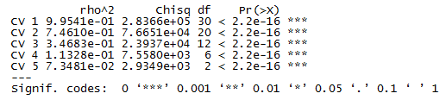
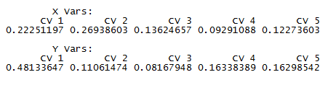
Canonical Correlation Analysis
A closer look at PC1 & PC2
Bartlett’s Chi-Squared Test:
Canonical Variate Adequacies :

Slide 22
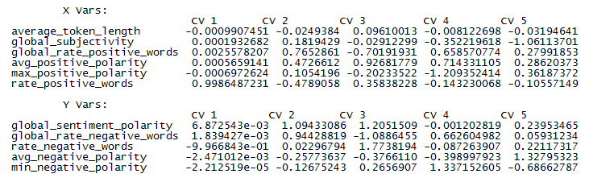
Canonical Correlation Analysis
A closer look at PC1 & PC2
Canonical Variate Coefficients:
Canonical Communalities:

Slide 23
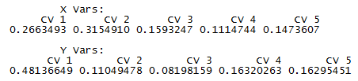
CCA
A closer look at PC1 & PC2 – Removing average_token_length
Canonical Communalities:
Canonical Variate Adequacies:

Slide 24
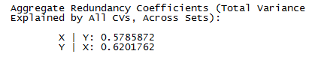
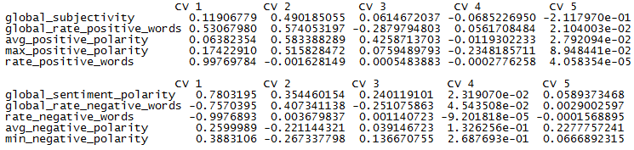
CCA
A closer look at PC1 & PC2 – Removing average_token_length
Aggregate Redundancy:
Cross Loadings:

Slide 25
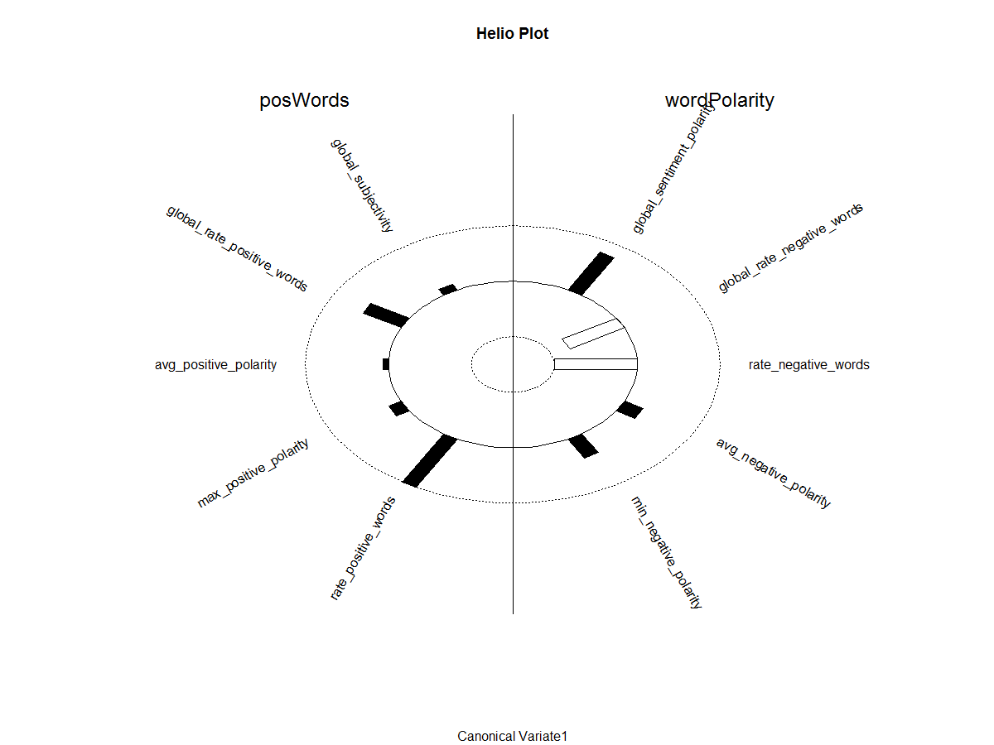
CCA
PC1 & PC2 – Another way to look at it

Slide 26
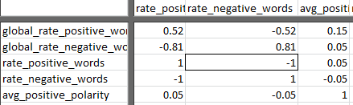
CCA
Takeaways
Average_token_length seems misplaced in PC1 and could be removed
Based upon the aggregate redundancies, there appears to be no predictive relationship between the principal components, other than PC1 and PC2
There is a moderate to strong correlation between PC1 and PC2, suggesting one could be removed. The redundancy coefficient is greater for PC2, so is the likely candidate.
Rate_positive_words and rate_ negative_words are nearly perfectly inversely correlated. The correlation matrix shows this as well. This suggests that one or the other could be removed.

Slide 27
Correspondence Analysis
Relationship between categorical variables

Slide 28
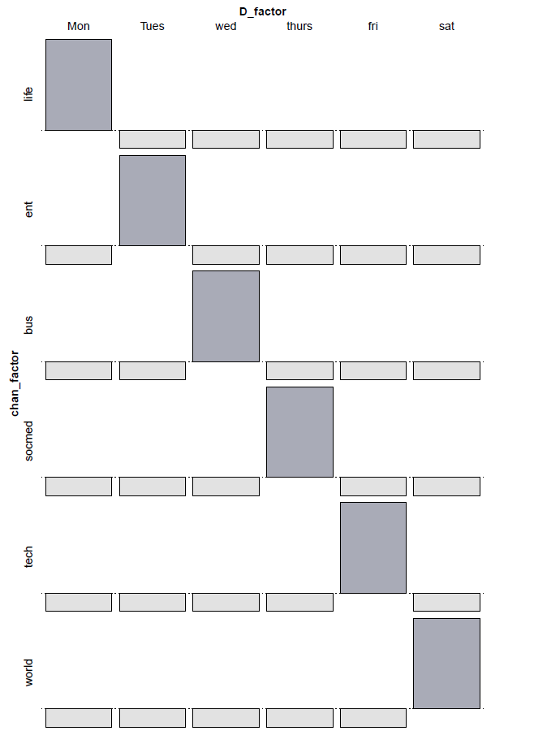
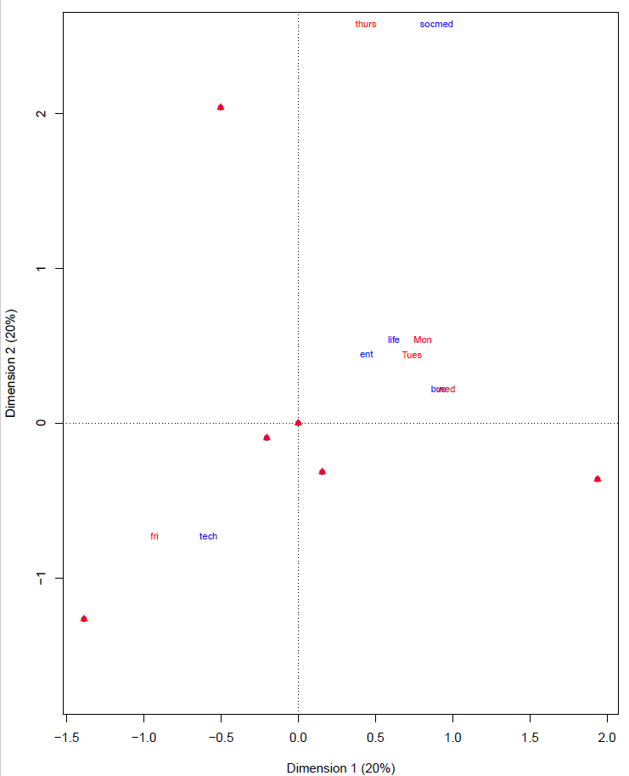
Correspondence Analysis
Day of Week – Data Channel
Monday – Lifestyle
Tuesday – Entertainment
Wednesday – Business
Thursday – Social Media
Friday – Technology
Saturday – World News
Association Plot
CA Plot
Notes:
Correspondence analysis was found to be useful to determine any correlation between our categorical variables, day of the week and Mashable data channel (article category). The idea behind this was to discover, within the dataset, the best day to publish a specific article category. As displayed, Monday was the best for lifestyle articles, Tuesday for entertainment content, Wednesday for business, Thursday for Social Media, Friday for Tech articles and Saturday for World news. Future application of this result can be beneficial for bloggers or those in the digital marketing industry to maximize their website popularity by posting subject-specific articles on the optimal day.

Slide 29
RANDOM FOREST
Classifying and predicting popularity

Slide 30
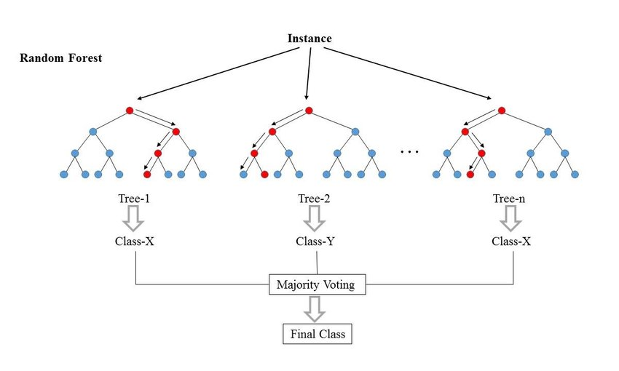
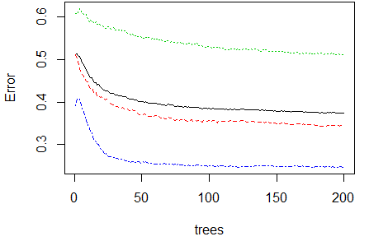
DECISION TREE & RANDOM FOREST
Ensemble methods: combine multiple models into one usually more accurate than the best of its components
Assuming that different group of students know different parts of the problem, would you agree on the majority vote/highly confident people to answer a question?
Leo Breiman: https://www.stat.berkeley.edu/~breiman/randomforest2001.pdf

Slide 31
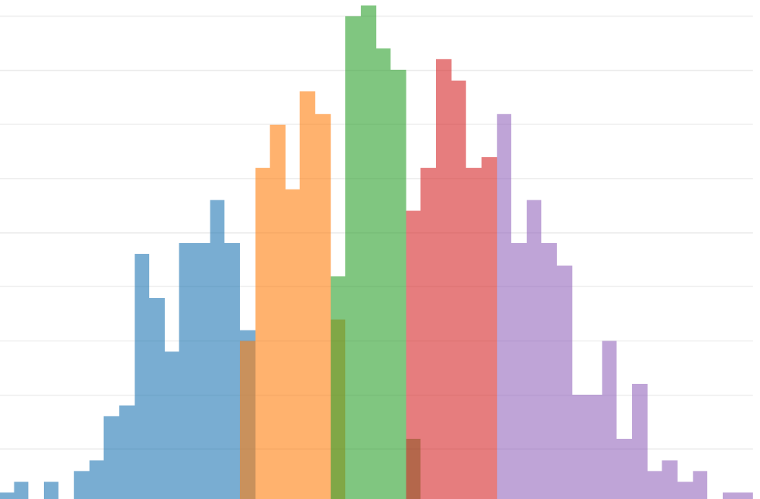
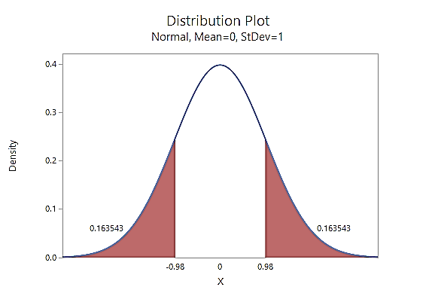
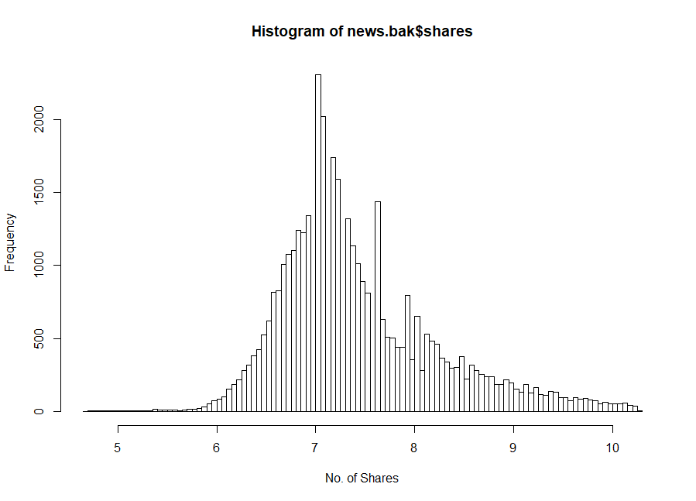
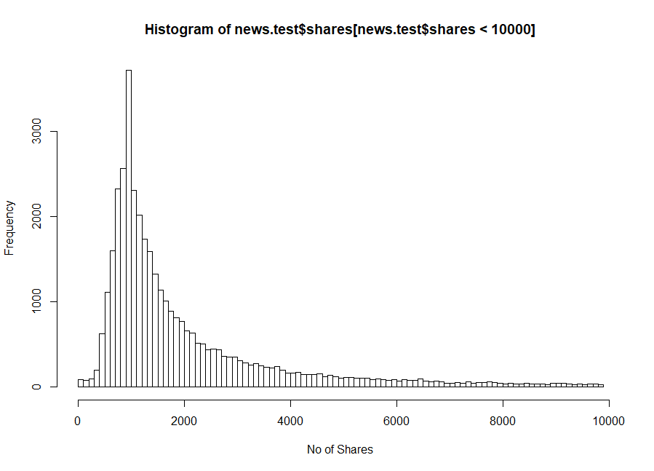
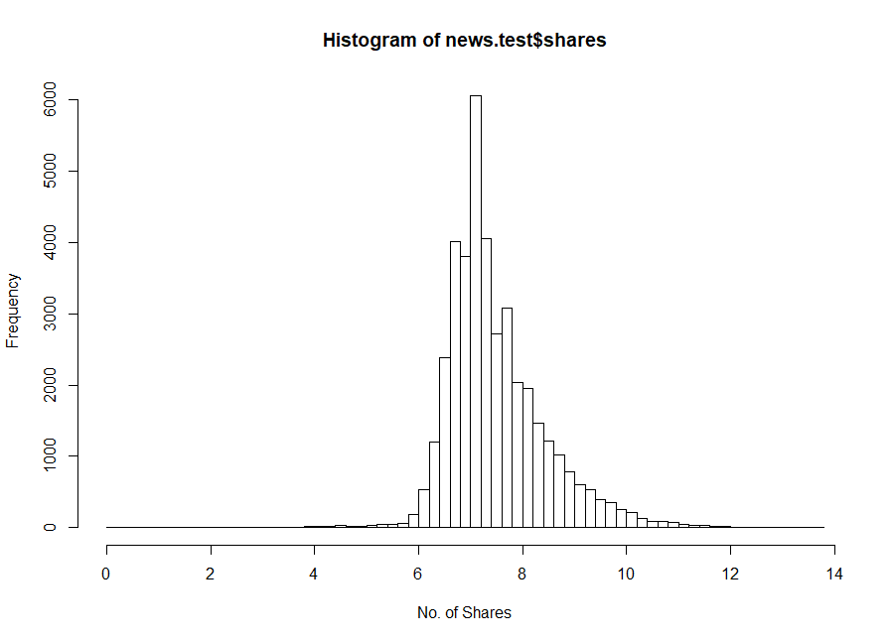
DECISION TREE & RANDOM FOREST
Preprocessing for Dependent Variable
Transformation: log base 10
Outlier Elimination: 3 SD
Discretization: Equal Frequency

Slide 32
DECISION TREE & RANDOM FOREST
Exploratory Random Forest
Equal frequency discretization of No of Shares – avoid class imbalance
Random Forest archived accuracy of 16.06%

Slide 33
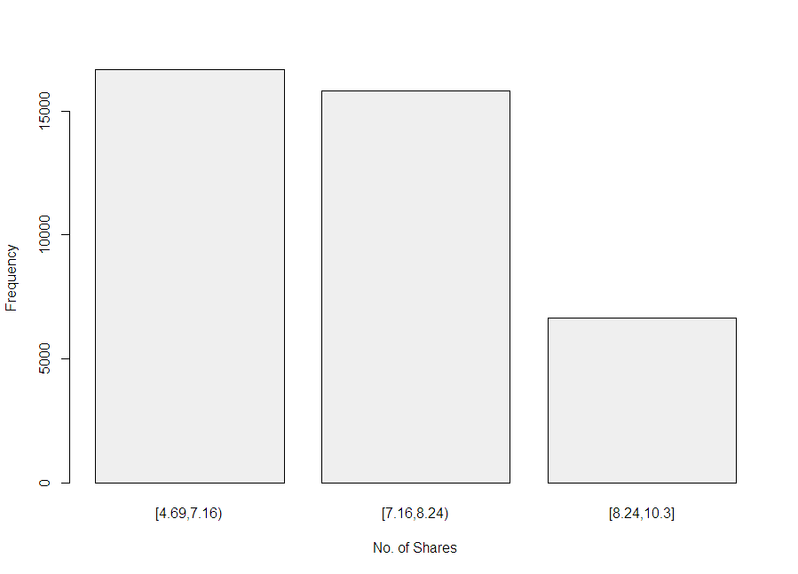
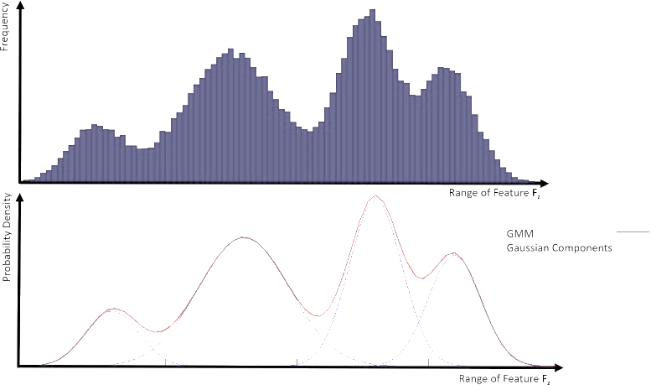
DECISION TREE & RANDOM FOREST
Kmeans Binning – assumes 3 Gaussians Distributions on No of Shares
Unpopular, moderately popular, highly popular
Imbalance Class - Lower TP & acc for minority class
Classifier bias towards majority
Oversampling for Training
Final Accuracy: 61.66%
Accuracy: 53.17%
Imbalanced Data
58.46
49.12
37.11

Slide 34
DECISION TREE & RANDOM FOREST
Major drawback is interpretation
Different important features for different classes
> rf$importance
[4.69,7.16) [7.16,8.24) [8.24,10.3] MeanDecreaseAccuracy MeanDecreaseGini
n_tokens_title 5.166168e-04 -7.766817e-05 0.0156289540 0.0047115859 338.84022
n_tokens_content 4.534734e-03 -1.332381e-04 0.0339319024 0.0114774170 472.45821
n_unique_tokens 6.192437e-03 6.970443e-04 0.0396551713 0.0140274704 505.90666
n_non_stop_words 5.761827e-03 1.133808e-04 0.0355925759 0.0124831082 483.93419
n_non_stop_unique_tokens 4.196912e-03 1.323223e-03 0.0376761285 0.0129366988 522.14397
num_hrefs 5.000068e-03 -2.018295e-04 0.0396508958 0.0133006857 424.21274
num_self_hrefs 1.253355e-03 2.755613e-04 0.0141292079 0.0046542678 271.22523
num_imgs 6.071290e-03 4.793953e-04 0.0375373619 0.0133129310 293.35409
num_videos 1.902193e-03 4.301577e-04 0.0125485005 0.0044948793 172.40818
average_token_length 5.504985e-03 5.657308e-04 0.0313909082 0.0113400701 540.53647
num_keywords 1.230839e-03 -9.719020e-05 0.0126175844 0.0040830398 215.08763
data_channel_is_lifestyle 1.354320e-04 -1.486458e-04 0.0009151025 0.0002640441 32.71213
data_channel_is_entertainment 8.905437e-03 -3.613461e-04 0.0275383134 0.0111257048 103.36737
data_channel_is_bus 2.677285e-03 -8.217407e-06 0.0051461233 0.0024648919 44.93687
data_channel_is_socmed 2.125725e-03 1.041850e-03 0.0110270500 0.0043510868 72.20403
data_channel_is_tech 4.750693e-03 5.430916e-04 0.0195711592 0.0076081059 77.80117
data_channel_is_world 1.200596e-02 -2.766857e-03 0.0192530759 0.0089968462 91.29234
kw_min_min 1.656685e-03 1.146193e-03 0.0126057291 0.0046709166 122.38158
kw_max_min 3.844561e-03 -1.415013e-03 0.0336738805 0.0107051509 513.93127
kw_avg_min 4.684663e-03 4.607945e-04 0.0426429763 0.0142909704 557.03085
kw_min_max 2.408584e-03 7.476054e-04 0.0314111352 0.0102549969 330.78345
kw_max_max 2.799947e-03 8.811387e-04 0.0135322114 0.0052626792 134.88901
kw_avg_max 6.990600e-03 -3.623467e-04 0.0447921858 0.0154398710 589.86176
kw_min_avg 1.219783e-02 -1.255839e-04 0.0572815204 0.0210469371 448.34997
kw_max_avg 1.716788e-02 -3.676724e-03 0.1090735876 0.0367313238 781.68541
kw_avg_avg 3.169030e-02 -4.988854e-03 0.1352027051 0.0490759920 868.29925
self_reference_min_shares 1.043454e-02 -1.868644e-04 0.0894868426 0.0297787560 553.93198
self_reference_max_shares 7.153863e-03 -8.782570e-04 0.0675199390 0.0219555818 460.80810
self_reference_avg_sharess 1.085520e-02 -1.460123e-03 0.0893584245 0.0294518073 538.71923
weekday_is_monday 1.458937e-04 8.967653e-05 0.0028989208 0.0009280370 66.04808
weekday_is_tuesday -2.865519e-05 -6.227414e-05 0.0034846697 0.0009837619 68.98477
weekday_is_wednesday 1.537055e-04 1.060916e-04 0.0031898830 0.0010202804 69.09311
weekday_is_thursday 3.923267e-06 -9.085804e-05 0.0032382822 0.0009148589 67.03985
weekday_is_friday 3.641047e-05 1.096347e-04 0.0029649162 0.0009145766 65.89135
weekday_is_saturday 2.712722e-03 1.438390e-04 0.0058379362 0.0027291686 50.83056
weekday_is_sunday 6.414298e-04 1.572625e-04 0.0037520275 0.0013802865 42.49079
is_weekend 8.245777e-03 2.302920e-03 0.0290796064 0.0122320927 133.80714
LDA_00 6.305280e-03 8.214489e-05 0.0431341344 0.0148717007 566.11944
LDA_01 7.272241e-03 -7.517652e-04 0.0428624703 0.0148565609 574.44687
LDA_02 1.268381e-02 -1.913263e-03 0.0470927502 0.0176381074 584.42313
LDA_03 7.139212e-03 -7.817323e-04 0.0491749339 0.0166261304 548.15051
LDA_04 7.172014e-03 1.843992e-03 0.0528637916 0.0186270431 586.26942
global_subjectivity 4.909321e-03 4.590452e-04 0.0392865119 0.0133649754 540.63946
global_sentiment_polarity 3.838708e-03 1.425692e-03 0.0287771475 0.0102609089 481.24117
global_rate_positive_words 4.670970e-03 6.126597e-04 0.0303877737 0.0107507614 508.20401
global_rate_negative_words 3.159706e-03 7.778648e-05 0.0277760846 0.0092572584 486.10125
rate_positive_words 3.228194e-03 4.255460e-04 0.0263686644 0.0089830314 417.89133
rate_negative_words 5.085942e-03 7.808798e-04 0.0269233746 0.0099372202 408.88754
avg_positive_polarity 1.630004e-03 4.749453e-04 0.0304288253 0.0096074365 509.42022
min_positive_polarity 1.242510e-03 8.845798e-04 0.0234349292 0.0075689686 246.85013
max_positive_polarity 3.732565e-04 2.907649e-04 0.0147399916 0.0045261752 206.70452
avg_negative_polarity 1.772558e-03 -6.688911e-05 0.0282380381 0.0088556924 479.20168
min_negative_polarity 1.166035e-03 2.533163e-04 0.0184409190 0.0058836173 300.37199
max_negative_polarity 1.322640e-03 2.028844e-04 0.0144976979 0.0047676444 283.42259
title_subjectivity 1.909494e-03 6.081525e-04 0.0182763983 0.0062238324 273.84152
title_sentiment_polarity 2.141192e-03 2.618928e-04 0.0154268279 0.0053538930 315.35182
abs_title_subjectivity 1.069351e-03 6.514370e-04 0.0146808826 0.0048814075 262.96183
abs_title_sentiment_polarity 1.845187e-03 7.105689e-04 0.0173149911 0.0059535147 267.48979
Top 10 Features

Slide 35
LINEAR REGRESSION
Attempt to predict number of shares

Slide 36
LINEAR REGRESSION Predict the NUMBER of shares
Original research goal was to predict the NUMBER of shares
Various Regression Models
PC1
PC1 + PC2
PC1 + PC 2 + IVs removed from PCA + dummy coded categorical variables
PC1 + PC2 + IVs found important from other analysis
All 6 PCs

Slide 37
“BEST” LINEAR REGRESSION
“Best” model:
PC1 + PC3 +PC4 +PC6
Statistically significant model
F-test = 287
p-score = 0
Non-predictive model:
Multiple R2 = 2.8%
Adjusted R2 = 2.8%
Coefficients:
Estimate Std. Error t value Pr(>|t|)
(Intercept) 3281.5 39.9 82.34 < 0.0000000000000002 ***
p2$scores[, 1] 268.0 39.9 6.72 0.000000000018 ***
p2$scores[, 3] 1120.8 39.9 28.12 < 0.0000000000000002 ***
p2$scores[, 4] 693.3 39.9 17.40 < 0.0000000000000002 ***
p2$scores[, 6] 110.3 39.9 2.77 0.0056 **
---
Signif. codes: 0 ‘***’ 0.001 ‘**’ 0.01 ‘*’ 0.05 ‘.’ 0.1 ‘ ’ 1
Residual standard error: 7940 on 39639 degrees of freedom
Multiple R-squared: 0.0281, Adjusted R-squared: 0.028
F-statistic: 287 on 4 and 39639 DF, p-value: <0.0000000000000002

Slide 38
COMPARING MODELS
Evaluation
Final Thoughts
Random Forest
Trinary Classification of derived no of shares aka. popularity
What question are we trying to ask?
An oracle that predict #
The tendency of high reachability
61.66% accuracy
Linear Regression
Predicts the actual no of shares which more intensive but with larger variance
The model explains 2.8% of the variability of shares

Slide 39
strong emotion is key
Journalist and bloggers should bring strong emotion (negative and positive) to their writing in order to get their news articles to be shared
Day of week & channel does matter
Future analysis should be done on the long term risks of exposure to news that is heavily reliant on strong emotions (and therefore bias)
Future analysis of outliers only, could bring new insights or hone existing analysis
Bonus: assess user comments as predictors of popularity
Conclusion
Notes:
Journalist and bloggers should bring strong emotion (negative and positive) to their writing in order to get their news articles to be shared
Day of week & channel does matter
Future analysis should be done on the long term risks of exposure to news that is heavily reliant on strong emotions (and therefore bias)
Future analysis of outliers only, could bring new insights or hone existing analysis

Slide 40
References
K. Fernandes, P. Vinagre and P. Cortez. (2015). A Proactive Intelligent Decision Support System for Predicting the Popularity of Online News. Proceedings of the 17th EPIA 2015 - Portuguese Conference on Artificial Intelligence, September, Coimbra, Portugal.
Tatar, A., Antoniadis, P., De Amorim, M. D., & Fdida, S. (2014). From popularity prediction to ranking online news. Social Network Analysis and Mining, 4(1), 174.
Bandari, R., Asur, S., & Huberman, B. A. (2012). The pulse of news in social media: Forecasting popularity. ICWSM, 12, 26-33
Tatar, A., Leguay, J., Antoniadis, P., Limbourg, A., de Amorim, M. D., & Fdida, S. (2011, May). Predicting the popularity of online articles based on user comments. In Proceedings of the International Conference on Web Intelligence, Mining and Semantics (p. 67). ACM.
Wu, B., & Shen, H. (2015). Analyzing and predicting news popularity on Twitter. International Journal of Information Management, 35(6), 702-711.

